Slide 1
CS410 – Course Project
Topic Modeling on Quora Q & A
Sushanta Panda (panda5@Illinois.edu)

Slide 2
Introduction
Many students try to explore various universities before they finally enroll into one of the University. All of them explore / search the internet to know more about the university, it’s curriculum, research areas, student’s academia and other interests. This search / re-search is somehow a tedious process and consumes lots of time. This Project is an attempt to simply the process and gives students the To 5 / 10 Topics discuss in the internet users discussed about certain university. This gives a glimpse of certain ideas what the university (or certain department of a university) is all about. For e.g., in the Top topics are discussed about “research” / “Professor” / “Good” / “Excellent”, then it creates an impression that the University or the searched department of a University is very well performed, as folks are discussing about the “research ideas” , and “Good” / ”Excellent” are the key topics mentioned in most of the documents. In other case, if the top topics discussed around “Tiring” / “Long” / “bad” etc., it doesn’t give an idea the certain department is doing well.
One can certainly be not 100% sure from the top topics, however it gives an ample idea what are the top things users are discussing about. Since internet is so broad and big, we limit ourself to the quora (www.quora.com) platform as the Q & A and limit the department to CS (Computer Science) and University is University of Illinois. Though we can configure the entire pipeline to pulled all these information from different platform (other than quora) and for other universities and other department, we are currently focus on how this prototype project will really work, rather to scale it up to certain levels.

Slide 3
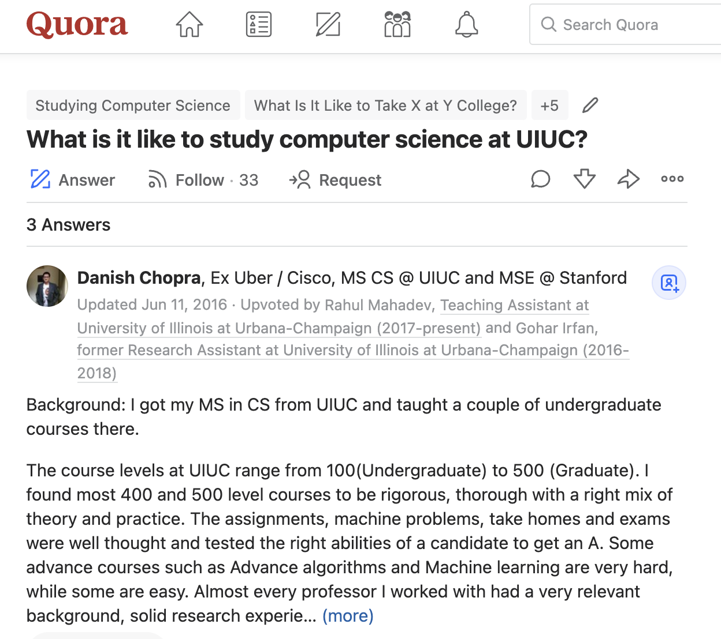
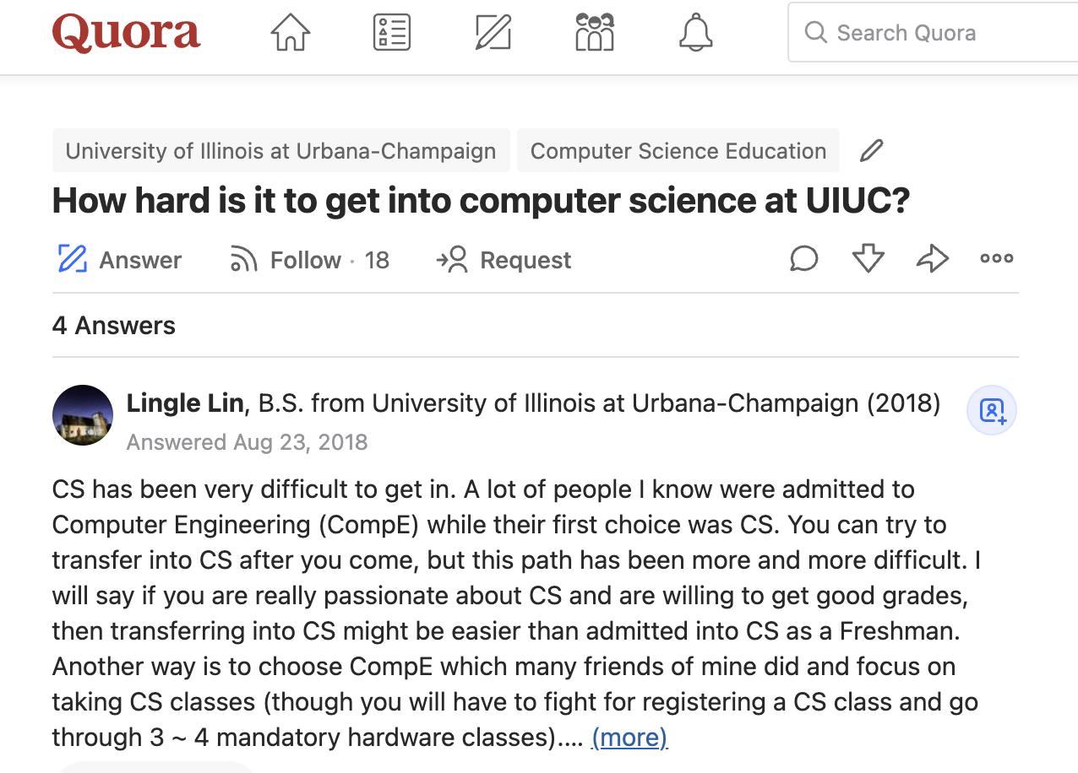
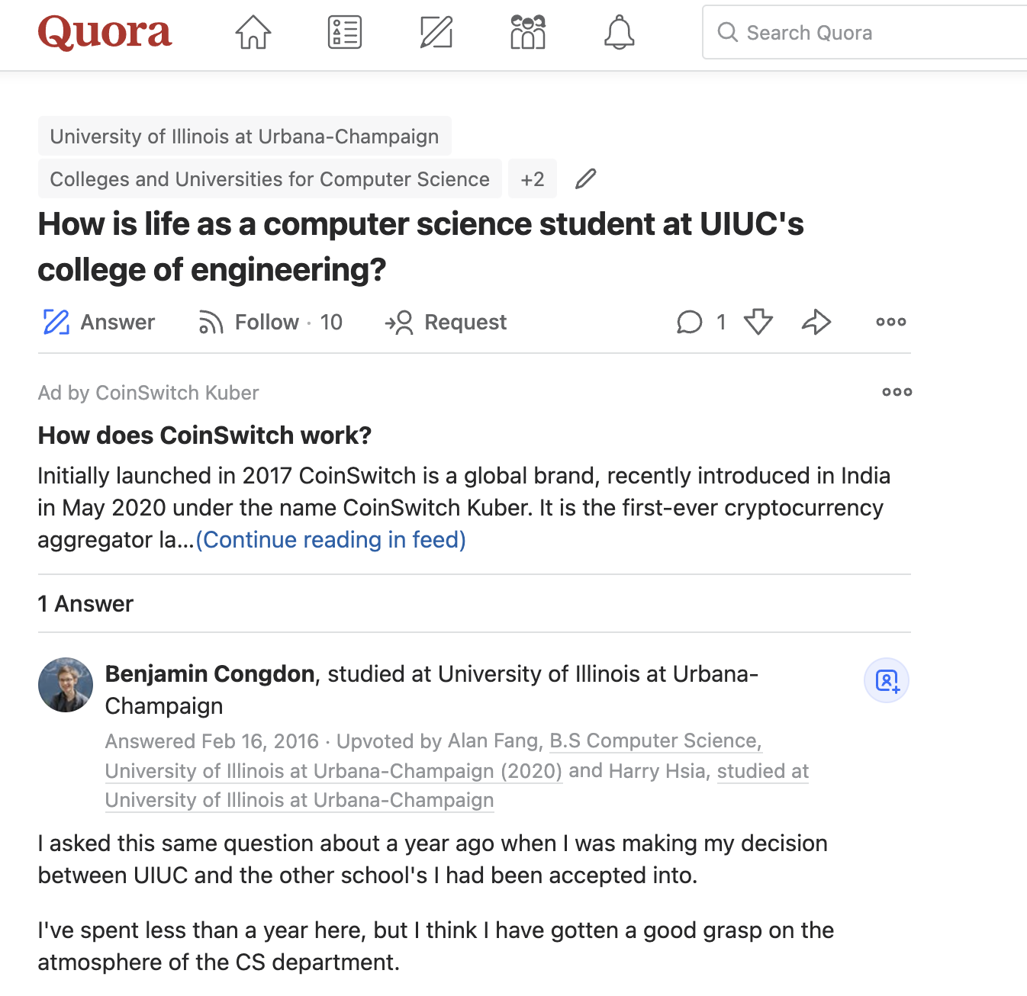
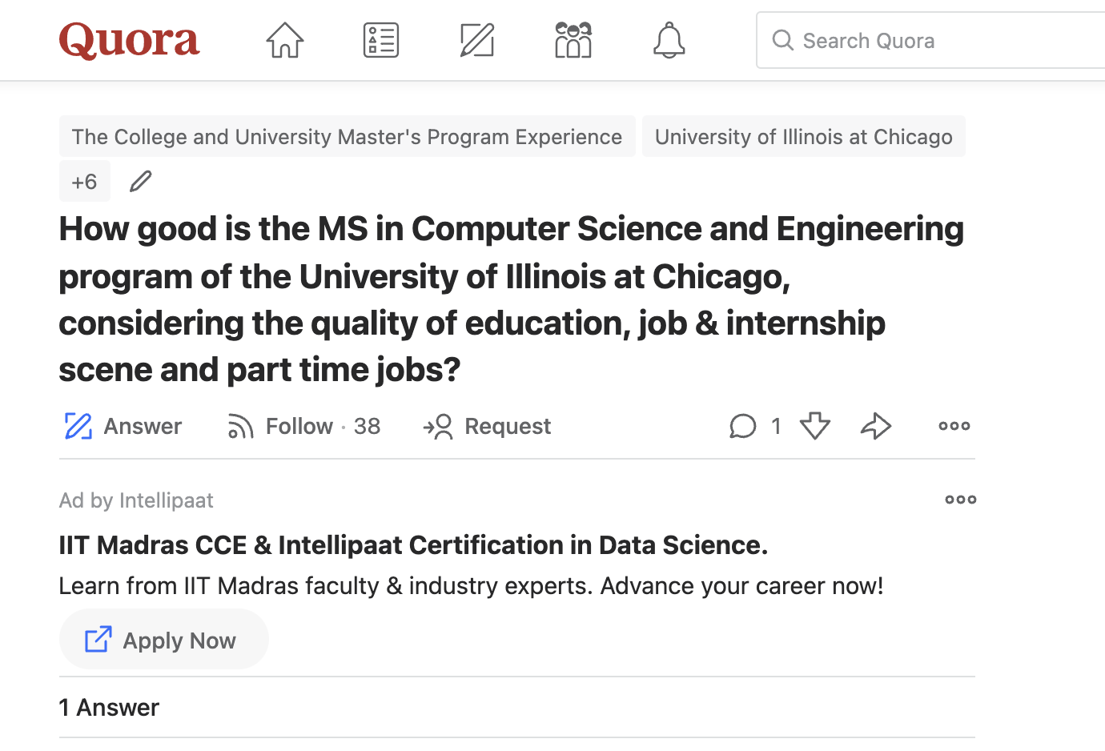
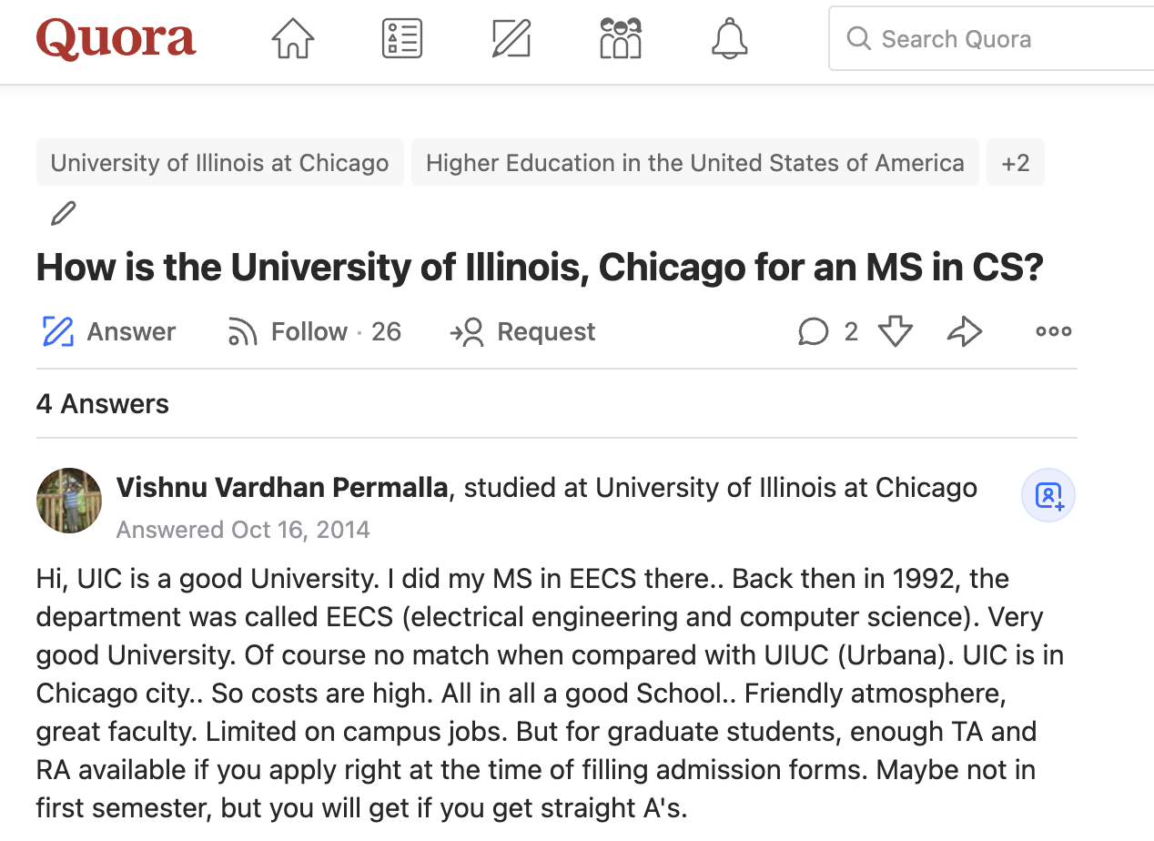
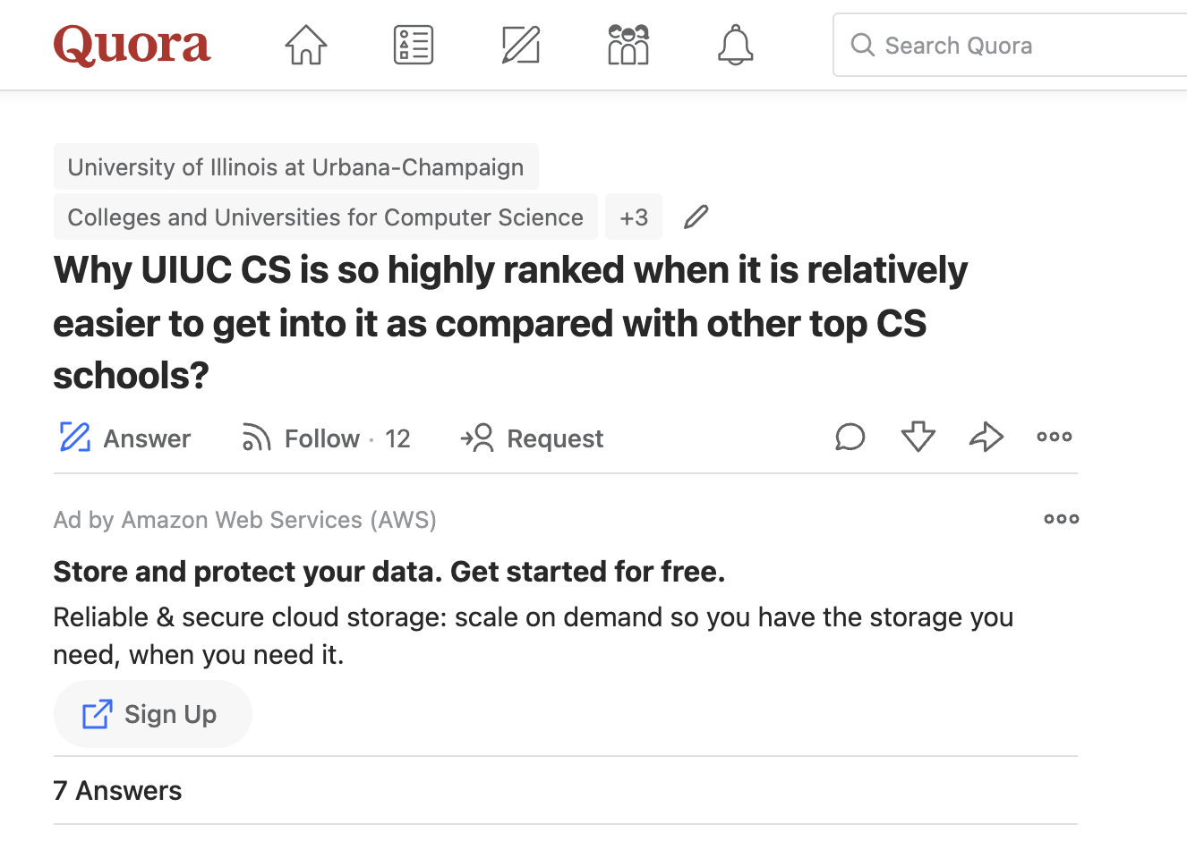
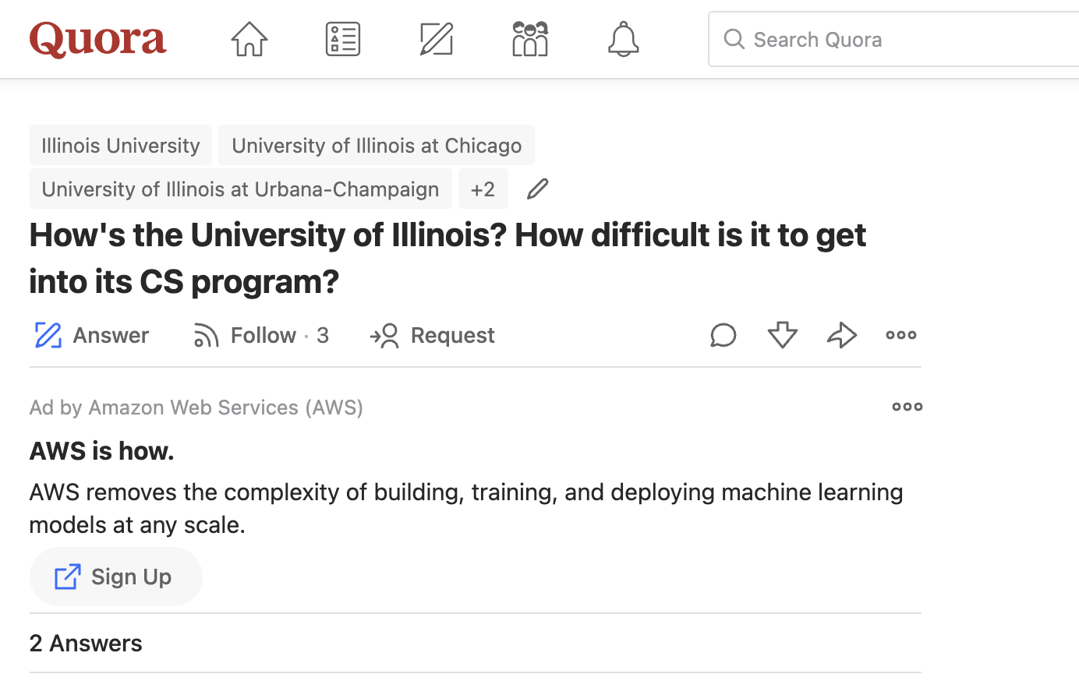
Datasets As part of the dataset, we have search in the google about the search words “University of Illinois Urbana Champaign” and “Computer Science” and “quora”, extract all the documents which are available. Based on these documents, we have extracted the ”questions” and all “answers” for each documents. Against one document, one question is attached. Below are some of the documents

Slide 4
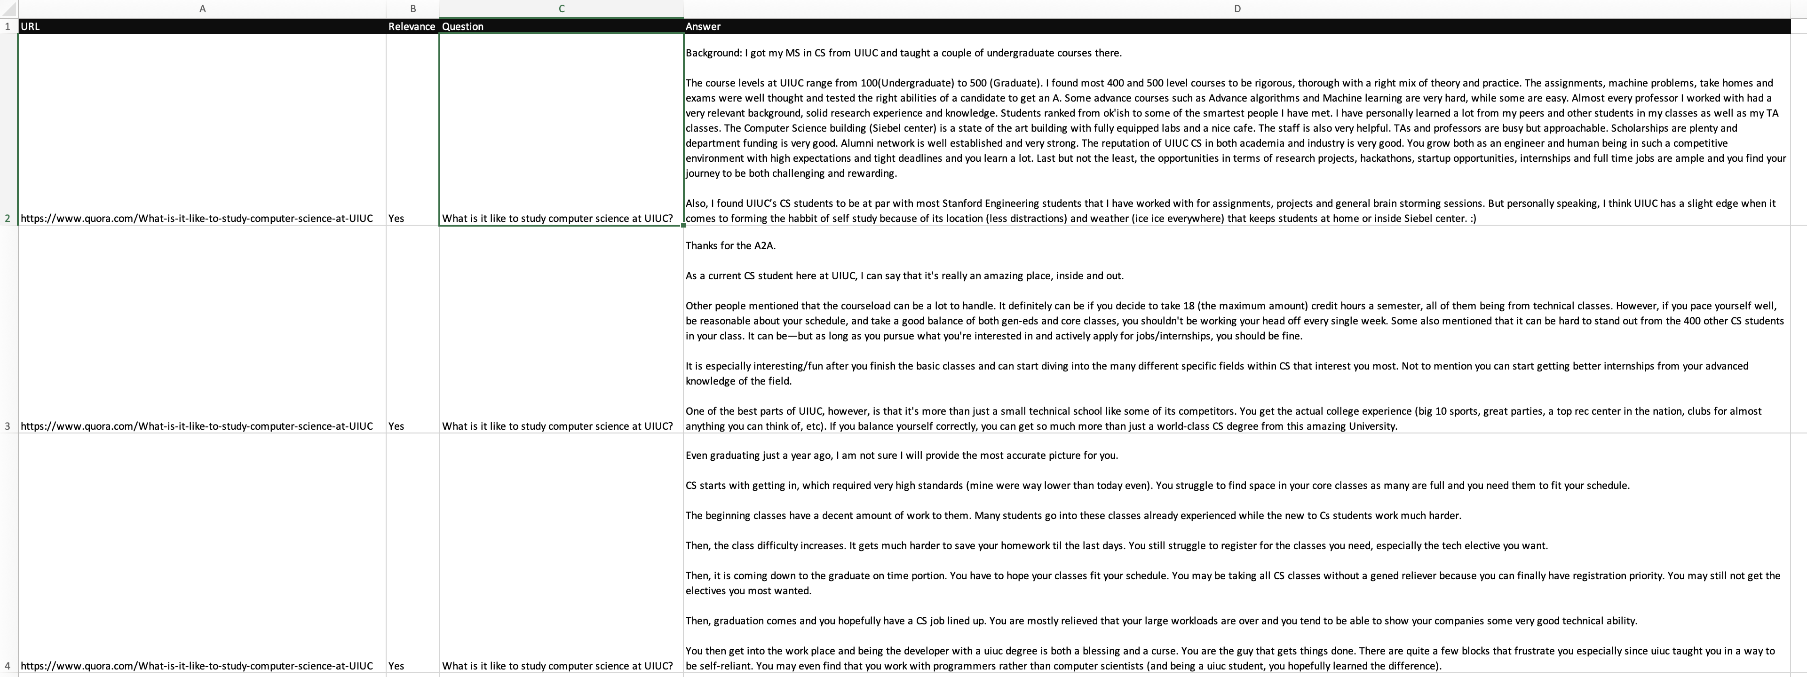
Dataset (Contd ..)
All the questions & answers are being captured in the form of a spreadsheet (manually) to feed into the system for the Topic Modeling. Following are the columns which are stored as part of the data collection
URL # URL of the quora Question
Relevance # Whether the question is relevance
Question # Text content of the question
Answer # Text content of the Answer

Slide 5
Code
From this section onwards will elaborate the details of the code. The code basically has 4 parts as below
Import Python Library
Importing data (collected manually)
Cleaning of the Data
Create the model to generate the Top K Topics

Slide 6
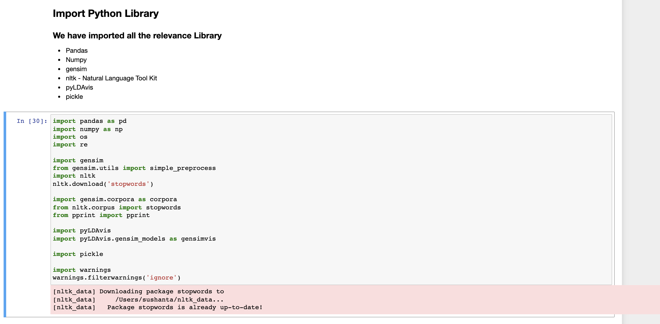
Code (Contd…)
Import Python Library
Below are the some of the python packages needs to import as part of the Program to run
pandas
Numpy
Gensim
Nltk
Pyldavis
Pickle
Left is the sample of the code

Slide 7
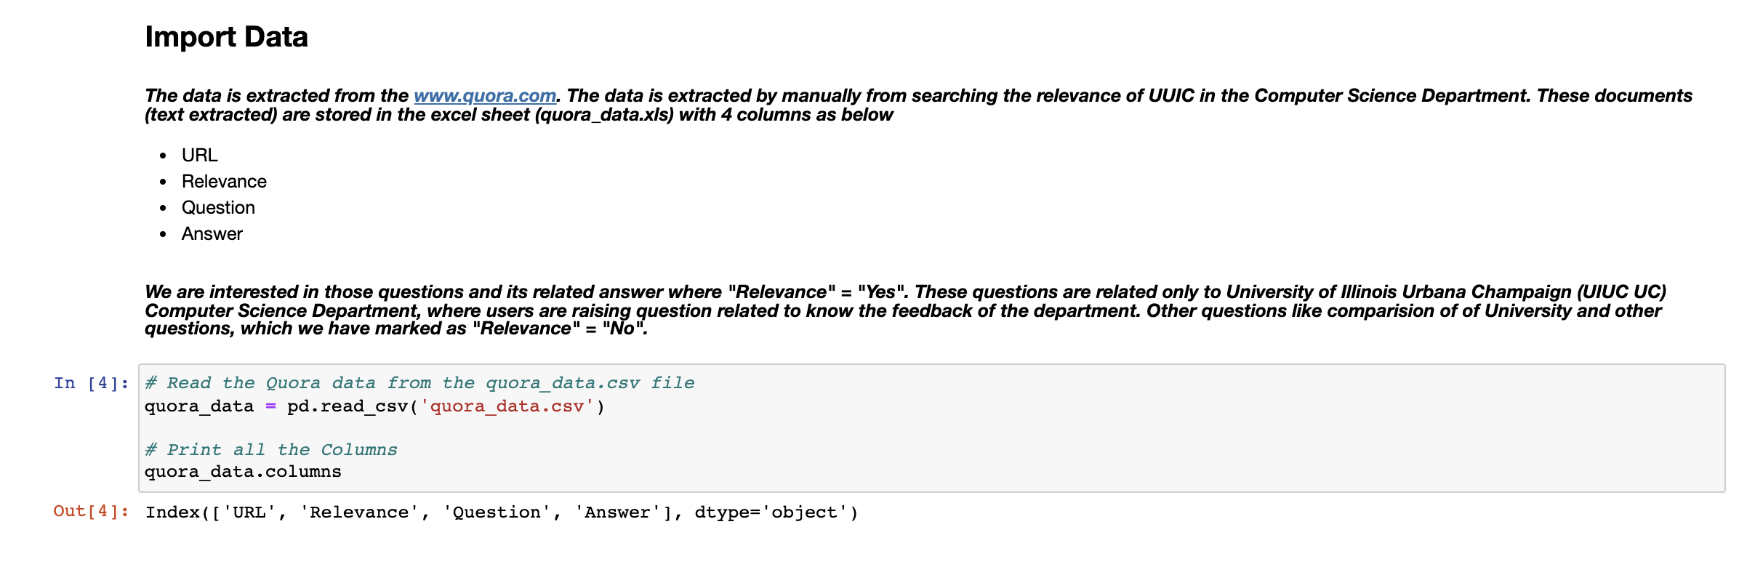
Code (Contd…)
Importing data (collected manually)
The excel sheet which is being captured all the data is converted into the csv file (manually). The csv file is then loaded into a dataframe via “pandas” library. However, since we are interested in only relevance document, will exclude in the next section of “data extraction” process and take out only the “Questions” column.
Left is the sample of the Code

Slide 8
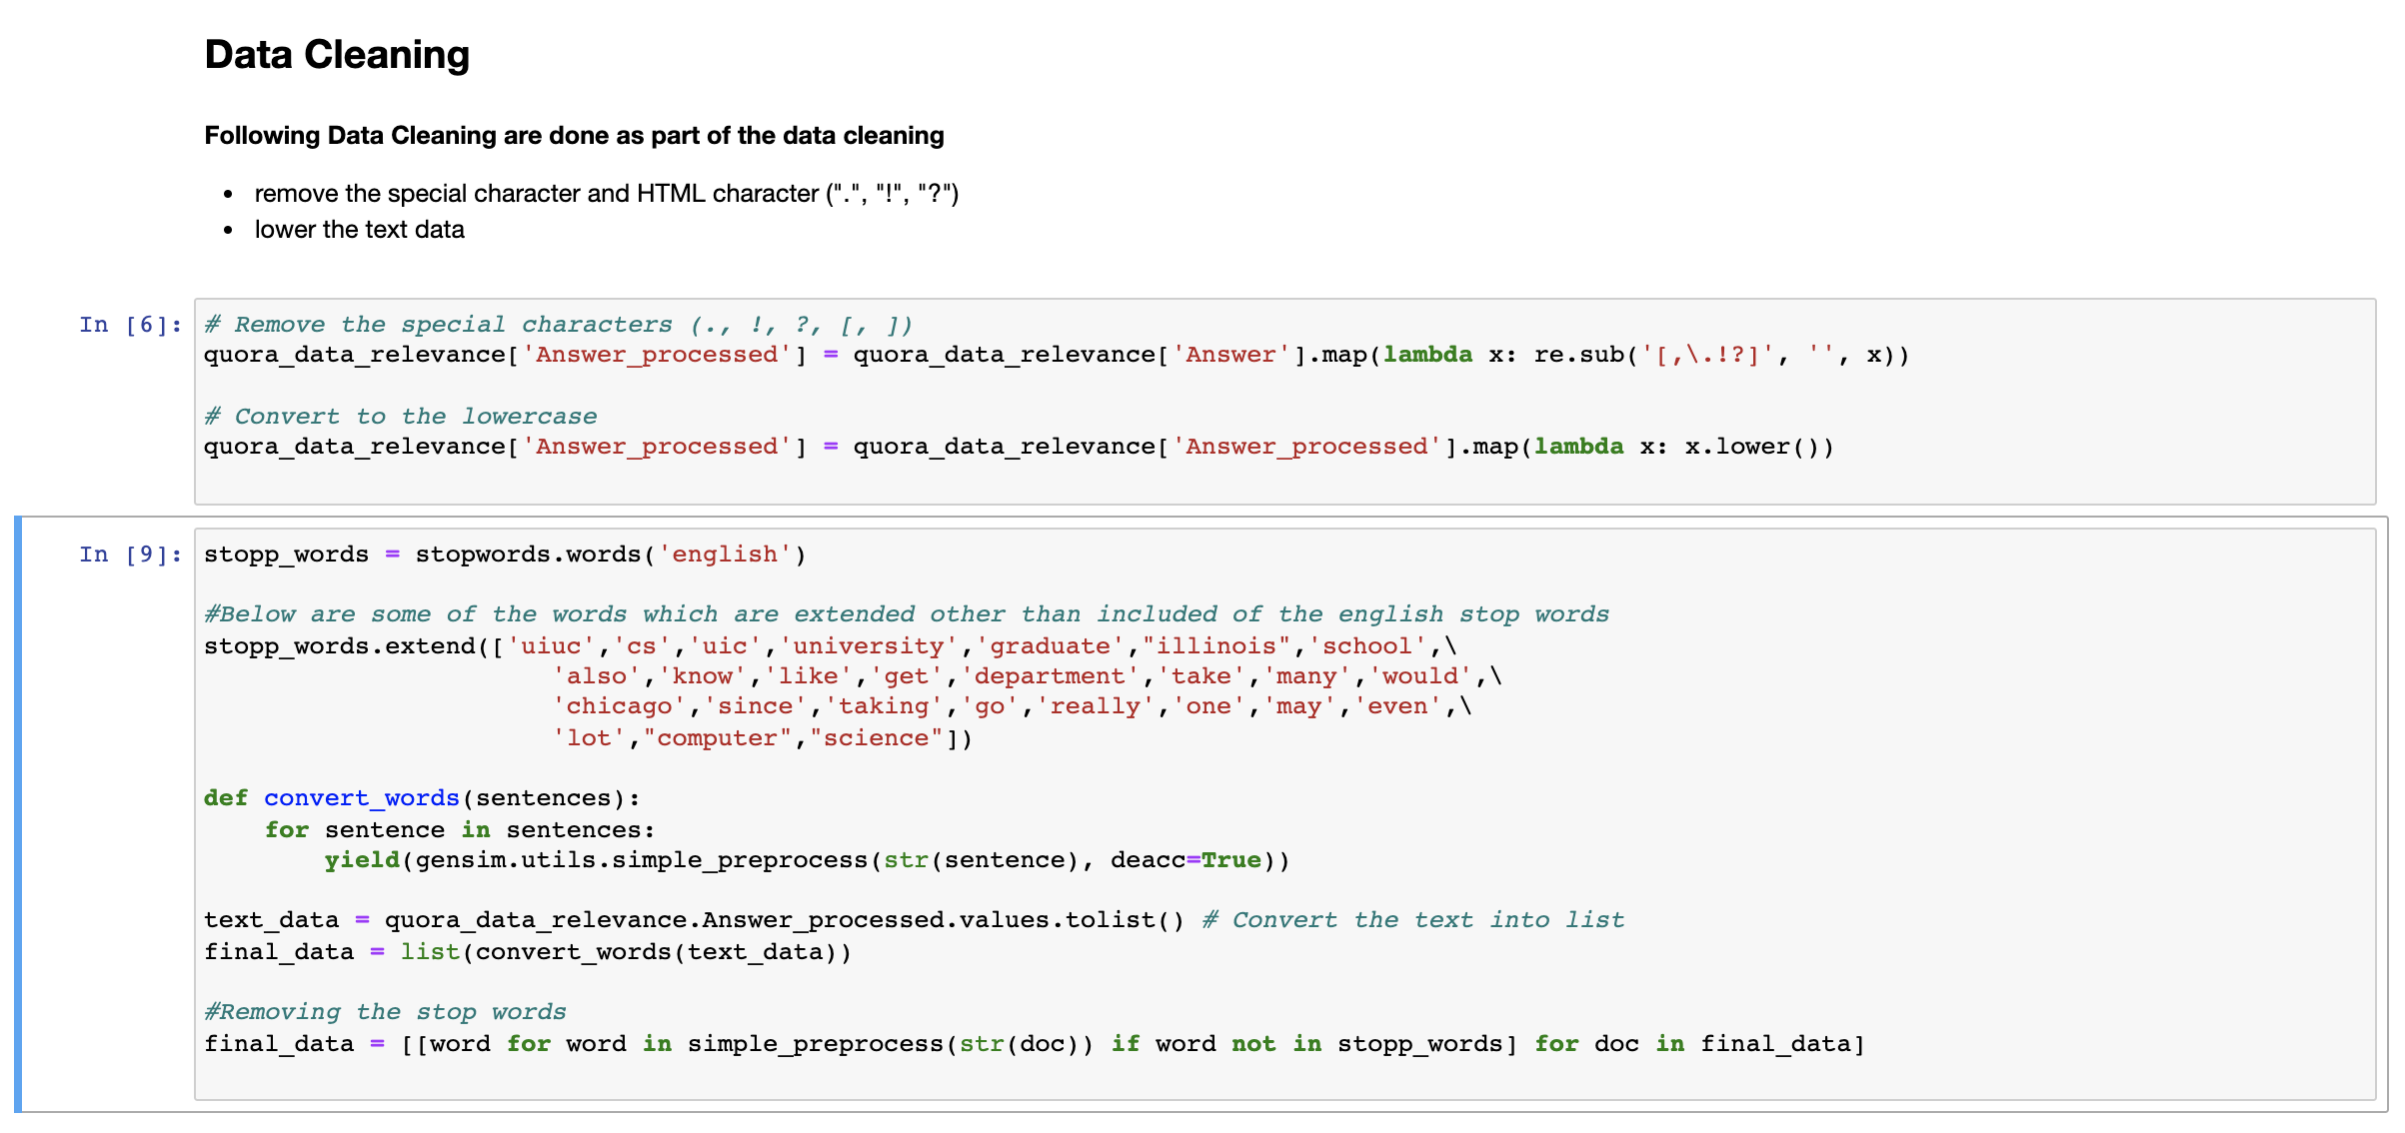
Code (Contd…)
Cleaning of the Data
As part of the data cleaning process, we will do the following tasks
Removing special characters
Removing the stop words. In addition to the nltk’s provided stop words, will add few of the stop words which we think are relevance to act as a stop words
Left is the sample code of the Data Cleaning

Slide 9
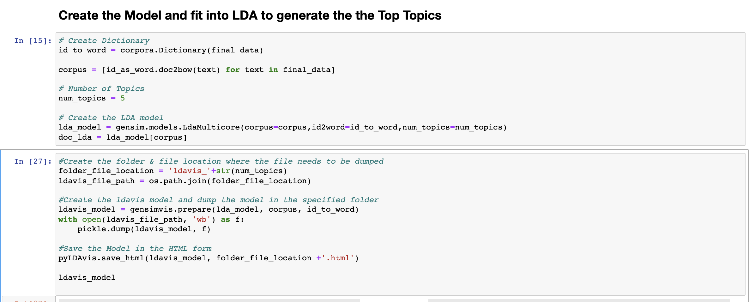
Code (Contd…)
Model & Find Top K Topics
This part of the code creates the model using the LDA and generate the K cluster where each cluster shows the Top Topics associated with the Answers from the Quora
Left is the sample code

Slide 10
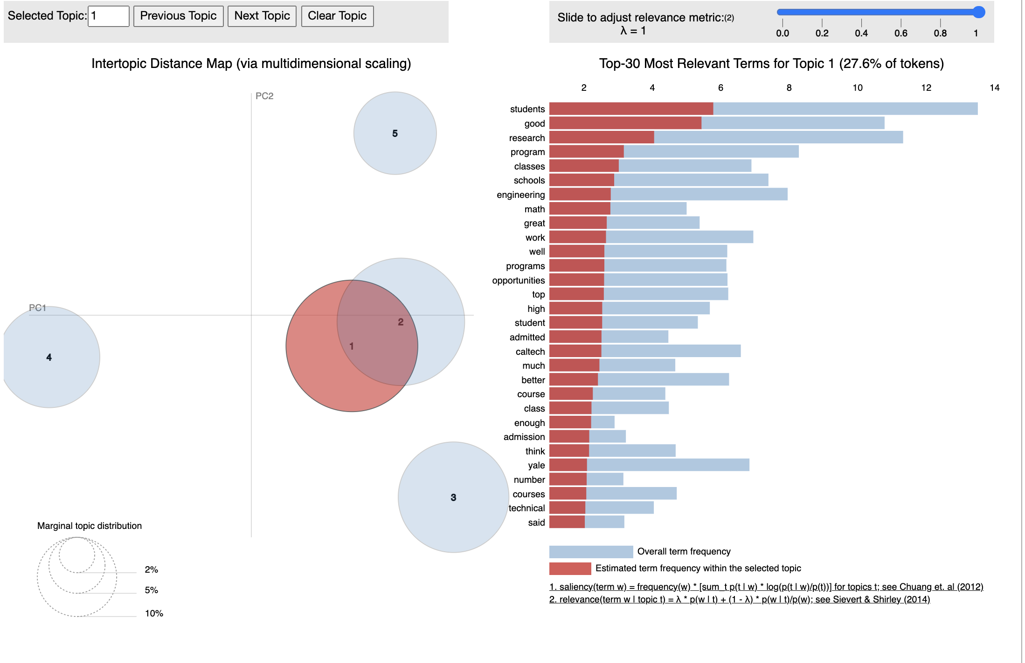
Top Topics via Latent Dirichlet Allocation (LDA)
There are 5 Cluster of Topics are being generated. The 1st Cluster of topics are shown in the image. We can see the top topics are “student” / “good” / “research” / “Program” / “classes”. This means that the UIUC’s computer science department is well received by users and most of them are praising the University and the Computer Science Department field.

Slide 11

The End

